Slide 1
On my adventures with static analyses for JavaScript
Francesco Logozzo
Herman Venter, Jacques-Henri Jourdan

Slide 2
Motivation
JavaScript
In every Web browser
In every web page?
Large and complex applications
Microsoft Office Web Apps
Facebook
Garmin Connect
…
Performance matters!
Correctness too!
Very dynamic
Cannot be statically compiled into efficient code

Slide 3
Just in time compilation (JIT)
Fully interpreted solution: too slow!
Modern implementations: use JIT
When f encountered at runtime
Compile to f’ in some assembly code
Execute f’
Performance gain pays off extra-compilation
Quality of f’ code depends on available information
Ex. Runtime values for type specialization
Goal: Infer as much as static information to help the JIT
Reality: Some analyses worked, some other did not…

Slide 4
Example: No type info
function nestedLoops() {
var i, j;
for (i = 0; i < 10000; i++) {
for (j = 0; j < i; j++)
;
}
}
JIT should generate
value wrappers
if(i.typeCode == Double)
var tmp = (Double) i.value
i.value = (object) tmp + 1.0
else
throw new TypeException()
i++
JIT
310 ms
Boxing/unboxing very expensive

Slide 5
Example: Simple type inference
function nestedLoops() {
var i, j;
for (i = 0; i < 10000; i++) {
for (j = 0; j < i; j++)
;
}
}
Infer
i, j : Float64
i : Float64
…
i = i + 1.0
i++
JIT
180 ms
Incr of Float64 still expensive

Slide 6
Example: RATA
function nestedLoops() {
var i, j;
for (i = 0; i < 10000; i++) {
for (j = 0; j < i; j++)
;
}
}
Infer
i : [0, 10000]
j : [0, 9999]
Ergo
i, j : Int32
i : Int32
…
i = i + 1
i++
JIT
31 ms
as fast as the C# Implementation

Slide 7
JavaScript numerical values
Only numerical type Float64
64 bits IEEE 754 standard
Exact representation for integers ∈ [-2⁵³, 2⁵³]
Special values for ±∞, NaN,
Ex. ∞ == 1/0, NaN == ∞/ ∞
Can specialize x: Float64 to x: Int32 if
x ∈ [-2³¹, 2³¹-1]
x is never assigned a fractional value
x is never assigned NaN
RATA Goal: Enable the specialization to ints

Slide 8
Should track values
Infer
i : [0, +∞]
j : [0, 1000]
Ergo
i : Float64
j : Int32
function bigNestedLoops() {
var i, j;
for (i = 0; i < 10000000000; i++) {
for (j = 0; i < 1000 && j < i; j++)
;
}
}
Term-based type inference not enough
Pattern-matching algorithms too rough
Should track values
Complex Loops
Use Abstract interpretation!

Slide 9
Abstract Interpretation
General theory of discrete approximations
Concrete domain
The most precise information on a program
Abstract domain
Keeps the information of interest
Can be of infinite height
Use widening/narrowing to ensure convergence

Slide 10
RATA
Combination of 3 analyses
Interval analysis
“Which is the range of a variable?”
Kind analysis
“Does a variable assumes a fractional value?”
Variation analysis
“Is the growth of a variables subsumed by another one?”

Slide 11
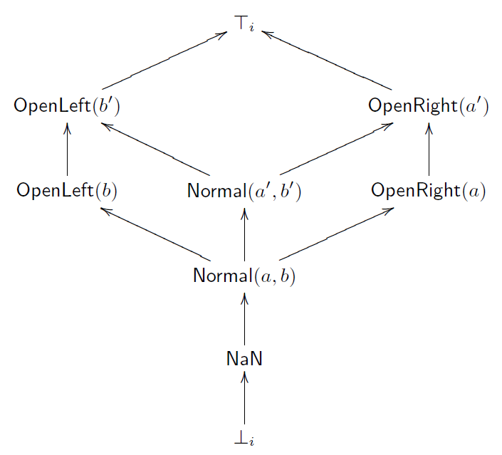
Interval analysis
Abstract a set of values with an interval
Slight variation of the original [CC77]
Abstract elements
Lattice structure
a ≤ a’, b ≤ b’

Slide 12
We need to track more more…
A variable assumes only integral values
Relations between variables
function div(b) {
// …
m = 1 / 2;
}
m is not an Int32
function bitsinbyte(b) {
var m = 1, c = 0;
while (m < 0x100) {
if (b & m) c++;
m <<= 1;
}
return c;
}
Infer
m : Normal(1, 512)
c : OpenRight(0)
b : T

Slide 13
Kinds
Tracks fractional values
Order: Subset inclusion
Not interesting by itself
i.e. Simple type analysis
Powerful when combined with Intv
Abstract Domain: Intv x Kind
Example:
γ(〈 OpenRight(10), Int32 〉)
= γ(〈 Normal(10, 2³¹-1), Int32 〉)
= {10, 11, … 2³¹-1}

Slide 14
Example of widening/narrowing
More powerful than usual “monotonic frameworks”
Analyze loopToN with
n : α ({9999}) = 〈 ⊤ , Int32 〉
loopToN(99999);
function loopToN(n) {
var x;
x = 0;
while (x < n) {
x = x + 1;
}
}
With widening infer
x : 〈 OpenRight(0), Float64 〉
With narrowing refine
x : 〈 OpenRight(0), Int32 〉

Slide 15
Relational analysis
function bitsinbyte(b) {
var m = 1, c = 0;
while (m < 0x100) {
if (b & m) c++;
m <<= 1;
}
return c;
}
Intuition: c cannot grow faster than m
For each iteration:
m ≠ 0 and multiplied by 2
C stable or incremented by one

Slide 16
Existing solutions
Use Relational abstract domains
Keep relation between variables
Examples:
Pentagons (x ∈ [a, b] ∧ x < y)
Slightly more than linear in practice
Octagons (± x ± y ≤ k)
Cubic
…
Problem: Too slow for runtime!
Super-linear complexity
Inadmissible for JIT ☹

Slide 17
Variation analysis
For each loop, for each variable x
Compute the variation range of x
Doable in linear time
Example
function bitsinbyte(b) {
var m = 1, c = 0;
while (m < 0x100) {
if (b & m) c++;
m <<= 1;
}
return c;
}
v(m) : [1, +∞]
v(c) : [0, 1]
v(b) : [0, 0]

Slide 18
Refinement Theorem
Let
σ₀ the abstract entry state of the loop
σ the loop invariant
If x ≠ y and
σ₀ ⊨ x < y
σ ⊨ y ≤ b, b: Int32
v ⊨ x < y
Then it is sound to refine σ with
σ’(x) = σ[x ↦ σ (x) ⊓ 〈 OpenLeft(b), ⊤ 〉]

Slide 19
Example
function bitsinbyte(b) {
var m = 1, c = 0;
while (m < 0x100) {
if (b & m) c++;
m <<= 1;
}
return c;
}
Infer
m : 〈 Normal(1, 512), Int32 〉
c : 〈 Normal(0, 512), Int32 〉
b : T
Not the best upper bound for c
Need more refined reasoning
Good enough for our purposes
Type specialization

Slide 20
RATA Algorithm
Static analysis at runtime!
When f(k) is encountered at runtime
Set up the initial state with α({k})
Ex. α({123}) = 〈 Top, Int32 〉
Run the analysis of the f body
Infer an atomic type at each program point
Join the abstract values ∀ program points
Infer an atomic type for the whole method
Abstraction to simplify code generation

Slide 21
Experiments
Implemented in a JavaScript interpreter
Generates .NET bytecode on the fly
Compare
Type inference for Float64
RATA
RATA overhead is minimal
Order of magnitude of the background noise
So small that we cannot measure it

Slide 22
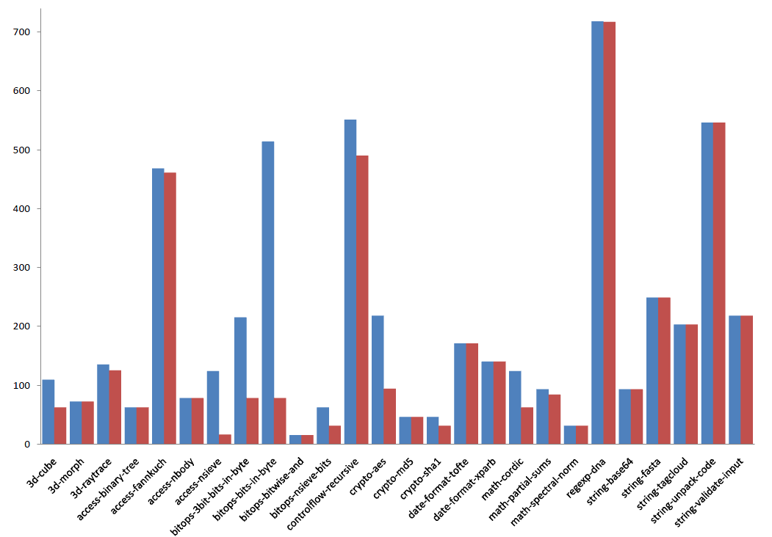
Results on SunSpider
Infer almost all the Int32 locals

Slide 23
Limitations: Globals
// In global scope
function foo()
{
x = 111;
}
var x = “hello”;
foo();
foo may change x and
set to some other type
// In global scope
var x;
while (x < 4) {
foo();
x = x + 1;
}
function foo()
{
x = “hello”;
}

Slide 24
Limitations: Arrays
Array can be refined
var a = new Array(10);
zeroarray(a);
function zeroarray(arr) {
var x = 0;
while (x < arr.length) {
arr[x] = 0; x = x + 1;
}
}
Length property in [0, 2³²]

Slide 25
RATA wrap-up
RATA: Rapid type analysis with abstract interpretation
Combination of 3 analyses
Ranges
Kinds
Variation
Results
Up to 7.7x speed-up in industrial benchmarks
Negligible analysis cost
Paper appeared in CC’09

Slide 26
Cool! Can we do more?
Enable more aggressive specializations
More global analysis
Infer compound types
Arrays
x : Int32[]
x.length : Int32
JavaScript allows Array redefinition
Data structures
Can generalize it for verification?
We tried those with Jacques-Henri…

Slide 27
Global analysis? Compound types?
We tried several approaches
Lightweight global analysis
Function summarization
…
Any of that worked
Essentially, we need a very refined global analysis
Way too expensive to be used at runtime
Why? Many reasons
The languages is too dynamic
E.g. “a + b” – anything can happen
Almost everything can be refined

Slide 28
Verification?
Idea: have JavaScriptContracts
With static checker a la Clousot
To verify, we should define “what” we verify
E.g. null is not necessarily an error
Define an assertion/contract language?
Again, the language is too dynamic for contracts to make sense
Anders Moeller’s team has a Type Analysis for JavaScript
Global analysis
Scalability issues
Use summaries?
Unclear how to validate them

Slide 29
Some more local static optimization?
Live variable analysis
Should we save tmp?
In C#, of course no
In JavaScript ?
function f(a) {
for (var i = 1; i < a.length - 1; i++) {
var tmp = a[i];
a[i] = a[i + 1];
a[i + 1] = tmp;
}
}

Slide 30
Some more local static optimization?
Live variable analysis
Should we save tmp?
In C#, of course no
In JavaScript ?
All variables are hoisted to function scope
function f(a) {
for (var i = 1; i < a.length - 1; i++) {
var tmp = a[i];
a[i] = a[i + 1];
a[i + 1] = tmp;
}
print(tmp);
}

Slide 31
Live vars analysis to Refine RATA
function f() {
var i;
print(i);
for (i = 0; i < 10000000; i++);
}
Is I an integer?
All variables initialized to undefined
Live variable analysis allows to refine RATA
i is an integer after print

Slide 32
Exceptions
Do we have to save tmp?
function f(a) {
try {
for (var i = 0; i < a.length; i++) {
var tmp = a.length;
a[i] = tmp + 1;
}
} catch (e) {
print(e);
print(tmp);
}
}

Slide 33
Exceptions
Do we have to same tmp?
Exceptions can arise (almost) everywhere...
function f(a) {
try {
for (var i = 0; i < a.length; i++) {
var tmp = a.length;
a[i] = tmp.valueOf() + 1;
}
} catch (e) {
print(e);
print(tmp);
}
}

Slide 34
Live variables analysis
What?
At that point of the program, will the value of this variable be used?
I never understood why not called “dead” variables analysis
Why?
Use in Spur
Local variables are often copied from a type-specialized location (registers) to unspecialized locations
Dead variables: no need to copy
Decrease stack memory consumption
RATA
At the beginning of a function, each local is undefined
undefined is neither integer nor a float
Should we take the initial value into account?

Slide 35
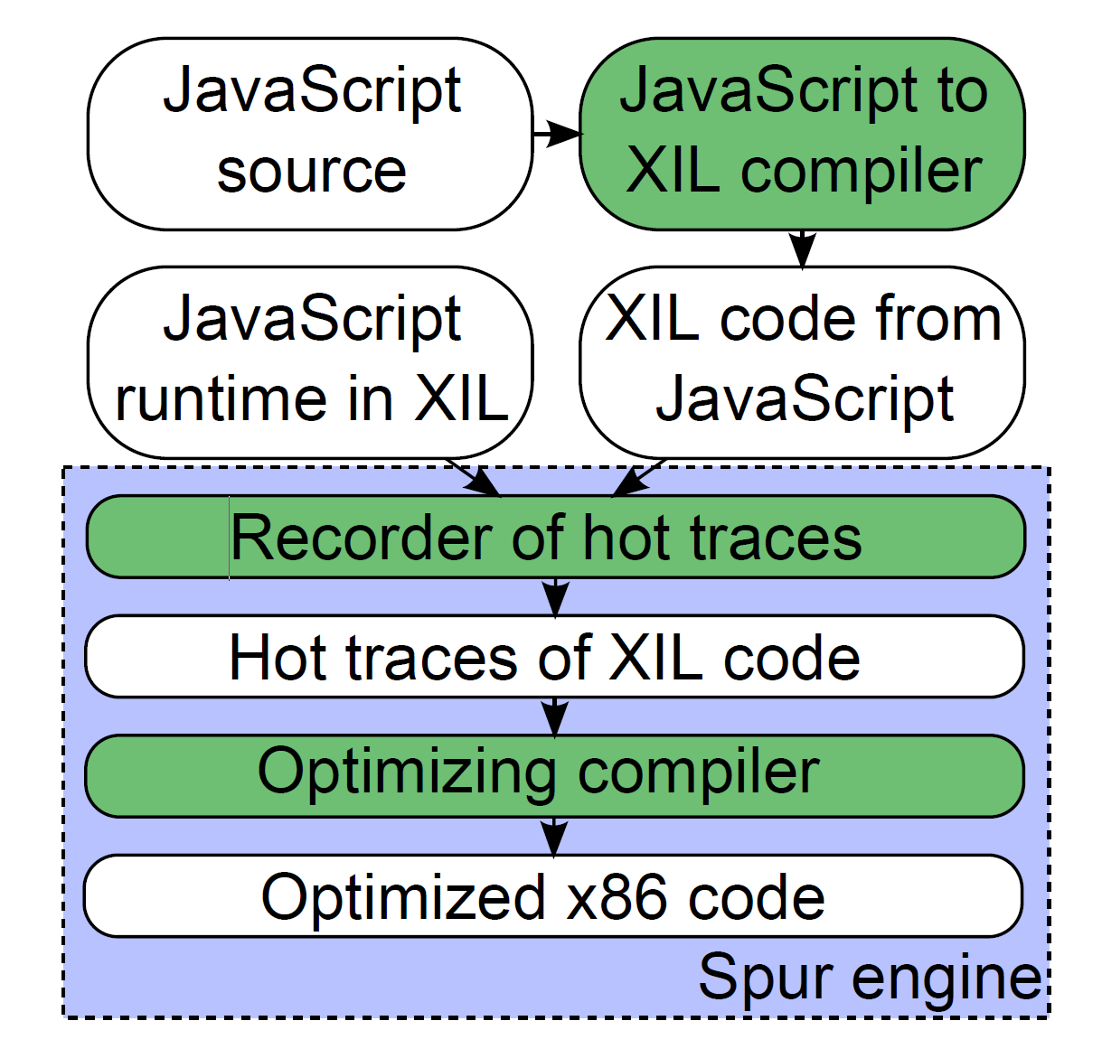
Spur

Slide 36
Dynamic vs static optimization
Spur uses dynamic information to optimize hot code
Some information lost by the JavaScript to XIL compiler
Code structure replaced by a control flow graph
XIL level: difficult to know when a local won't be used
Especially when we take the address of a local
Spur misses some optimizations
Live variable analysis for local variables at JavaScript level

Slide 37
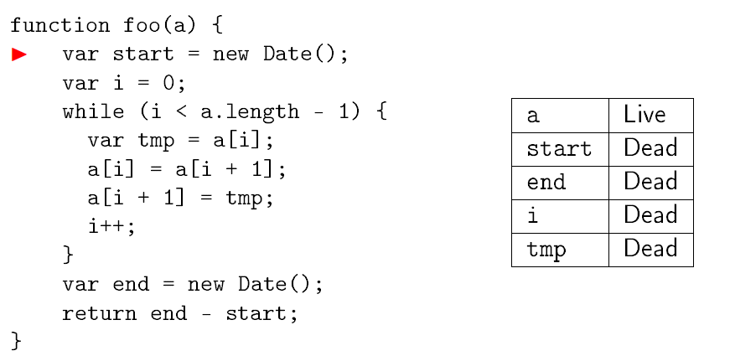
Example
Source level analysis
Th. Two iterations to reach the fixpoint!

Slide 38
The analysis
“Standard”
Backwards analysis
Initial state: all the variable are dead
Variable read: becomes live
Variable write: becomes dead
Branch: is the variable live in any branch?
New
Loop: fixpoint, only 2 iterations necessary
High-level constructs: break, continue, exceptions...
Should maintain the set of live variables after a break/continue/exception

Slide 39
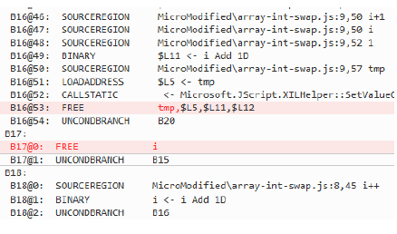
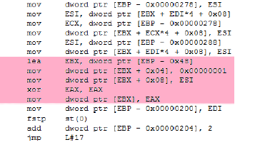
Generated code

Slide 40
So…
We generate better code
Fewer variables
Fewer instructions
We will have fantastic improvements!

Slide 41
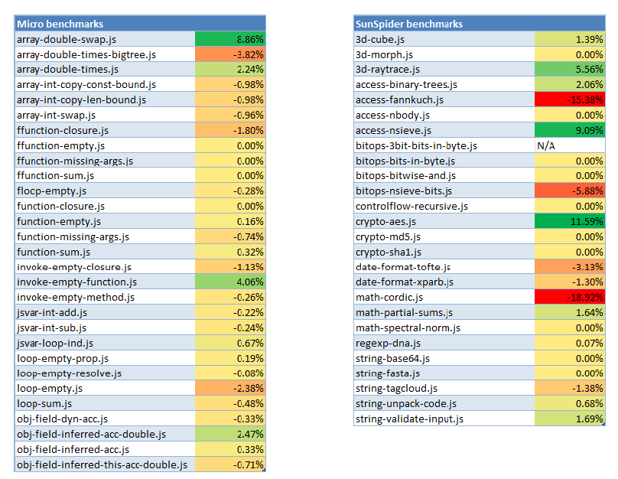
Experiments ☹

Slide 42
Conclusions
Explored several static analyses
RATA
Extension to global
JavaScriptContracts?
Live variable analysis
RATA works well, other have problems

